Slide 1


CHANGE DETECTION IN REMOTE SENSING IMAGES
A COUPLED DICTIONARY AND DEEP LEARNING APPROACH
Group : G6
IIT2021142-Subhendra Gautam
IIT2021162-Saransh Yadav
IIT2021165-Yash Singh
IIT2021196-Vishal Kumar
IIT2021206-Vivek Manwar
IIT2021261-Saikat Sadhukhan
SUPERVISED BY-
PROF ANUPAM AGARWAL

Slide 2
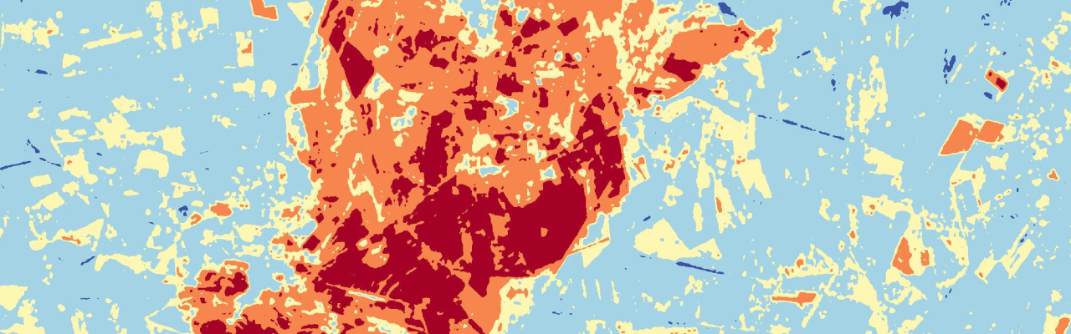
INTRODUCTION
Remote sensing technology, a pivotal tool in Earth observation, plays a crucial role in monitoring and analyzing changes occurring on the Earth's surface.
Through the utilization of satellites, aircraft, or other platforms equipped with remote sensing instruments, it enables the capture of imagery and data over vast geographical areas.
Change detection (CD) methods, a fundamental application of remote sensing, involve the analysis of images acquired at different points in time to identify and characterize changes that have occurred within the observed area.

Slide 3


INTRODUCTION
Remote sensing technology plays a crucial role in monitoring Earth's surface changes.
Change detection (CD) methods analyze remote sensing imagery to detect landscape changes.
They employ sophisticated analytical techniques to unveil nuanced alterations over time.
CD methods offer invaluable insights into environmental dynamics and urban development.
They contribute to disaster response, habitat monitoring, and informed decision-making in various sectors.
Significance
Change detection (CD) methods analyze remote sensing images to identify alterations.
Methodology
Information derived from CD methods is vital for land-use planning, disaster management, and urban expansion.
Applications

Slide 4

CHALLENGES OF EXISTING METHODS [1]
Traditional change detection methods face challenges in accurately identifying and characterizing changes in multi-temporal remote sensing images.
These challenges can hinder the efficacy of CD methods, potentially leading to incomplete or inaccurate assessments of landscape dynamics over time.
Challenge 01
Challenge 02
Pixel-based methods overlook spatial relationships, impacting change detection accuracy.
Edge pixel uncertainty hampers precise border delineation in change detection.
Challenge 03
Small object misclassification leads to inaccurate identification of subtle changes.

Slide 5
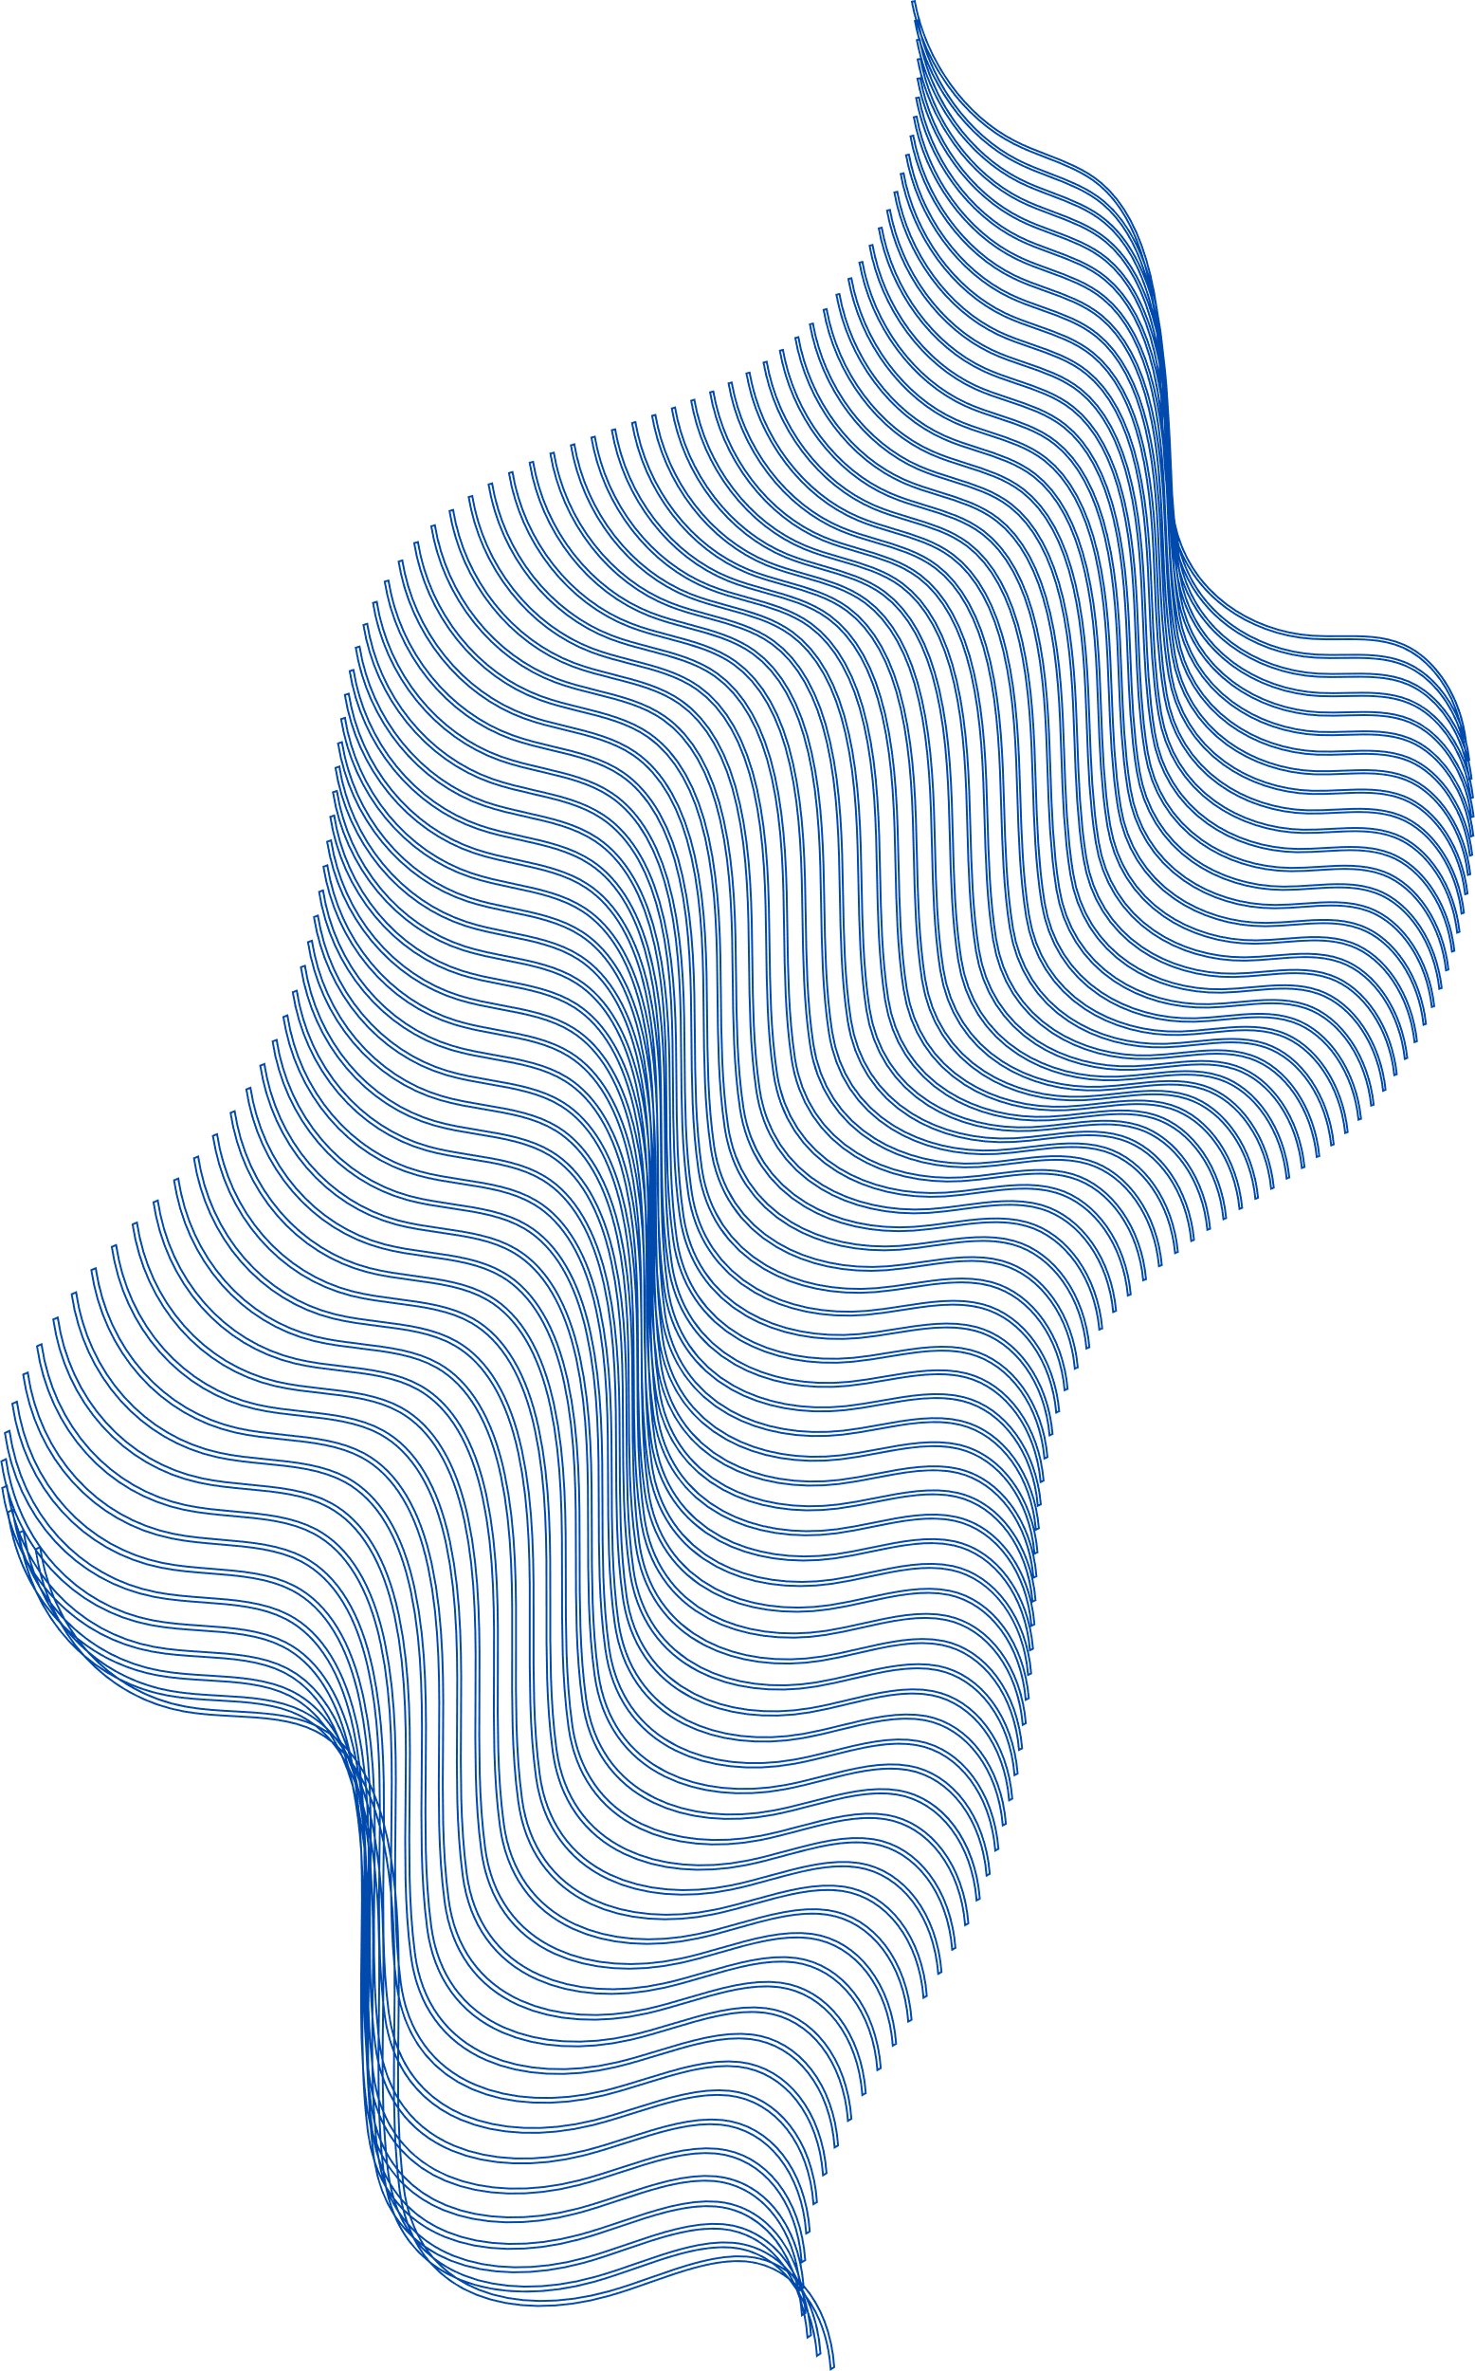
PIXEL-BASED METHODS [1]
Traditional change detection techniques analyze individual pixels independently.
Changes are detected based on pixel intensity or spectral characteristics.
Limitation: Ignoring spatial context leads to inaccurate results.
Missing contextual information can result in false positives or negatives.
Changes might go undetected or incorrectly identified, leading to erroneous conclusions.
Example: Urban expansion may be missed if only individual pixel changes are considered.

Slide 6
EDGE PIXEL UNCERTAINTY [1]
Traditional change detection methods often struggle with the uncertainty associated with classifying pixels at the borders of changing objects.
This uncertainty arises from abrupt transitions between different land cover types or features, making it challenging to accurately delineate change boundaries.
For instance, in satellite imagery monitoring urban expansion, distinguishing between developed areas and surrounding vegetation along edges can be difficult due to mixed pixel compositions.
These challenges can lead to inaccuracies in change detection results, impacting the reliability of assessments of landscape dynamics over time.

Slide 7
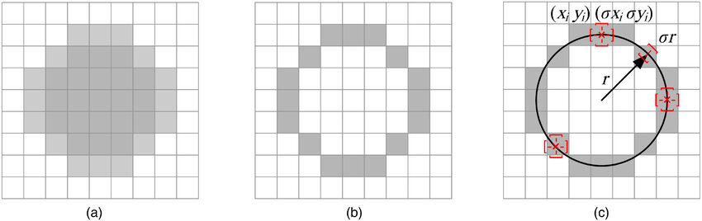
EDGE PIXEL UNCERTAINTY [1]
(a) A circle (b) Edge detection of circle (c) Smoothing of edge
Source

Slide 8
SMALL OBJECT MISCLASSIFICATION [2]
Traditional CD methods often struggle to detect changes in small features within the landscape.
They may overlook or misclassify subtle changes amidst the larger spatial context.
For example, detecting alterations in small-scale agricultural plots or individual trees within a forested area can be challenging.
This limitation can lead to inaccuracies in the change detection process, affecting overall accuracy.

Slide 9
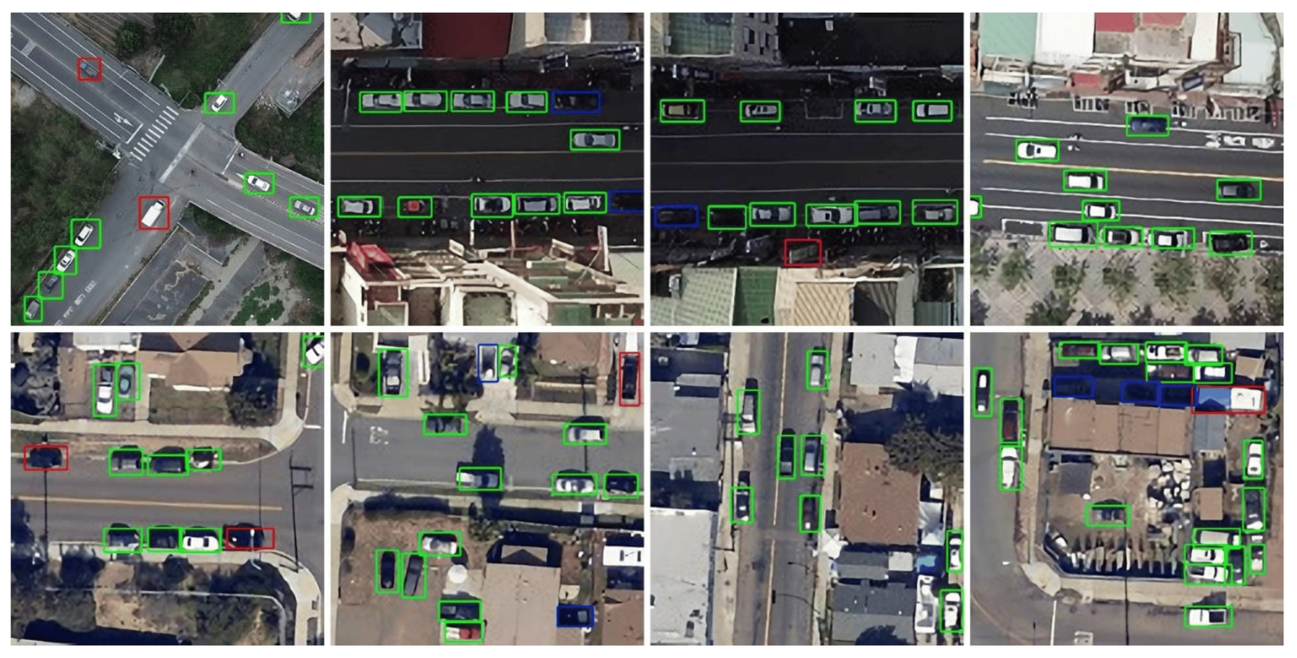
SMALL OBJECT MISCLASSIFICATION [2]
Source

Slide 10
DEEP LEARNING FOR CHANGE DETECTION
Deep learning has emerged as a powerful tool for CD. These methods can automatically learn complex features from remote sensing images, improving change detection accuracy.

Slide 11
TRADITIONAL METHODS VS.
DEEP LEARNING
Traditional Methods:
Traditional change detection methods rely on handcrafted features and predefined algorithms.
Examples include thresholding, differencing, and classification.
Limitations: Lack of adaptability to diverse datasets, inability to capture complex spatial and temporal patterns.

Slide 12
TRADITIONAL METHODS VS. DEEP LEARNING
Deep Learning:
Deep learning approaches automatically learn complex features directly from raw remote sensing data.
They enable the extraction of spatial and temporal patterns, improving change detection accuracy.
Deep learning represents a paradigm shift in change detection, offering greater adaptability and scalability.

Slide 13
DEEP LEARNING ARCHITECTURES FOR CD [3]
Deep learning architectures such as Convolutional Neural Networks (CNNs) excel in spatial feature extraction, allowing them to effectively capture intricate patterns and structures in remote sensing imagery.
Recurrent Neural Networks (RNNs) are proficient in modeling temporal dependencies, enabling them to analyze sequential data over time and detect changes in dynamic landscapes.
Fully Convolutional Networks (FCNs) and Convolutional Long Short-Term Memory Networks (ConvLSTMs) combine spatial and temporal information, offering a holistic approach to change detection tasks by simultaneously considering both the spatial and temporal aspects of remote sensing data.

Slide 14
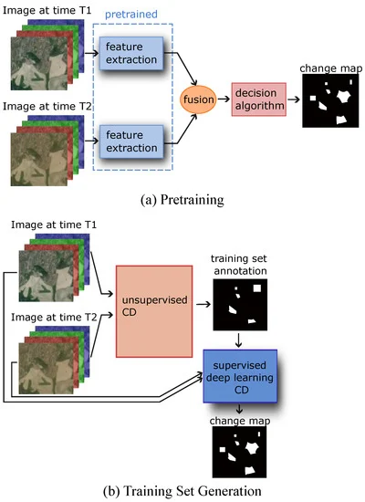
DEEP LEARNING ARCHITECTURES FOR CD [3]
Two possible unsupervised network structures.
(a) Network with pretrained feature extractors:
Feature extractors that have been pretrained on a related task are used to automatically extract image features. The features are then input into an automatic decision algorithm that compares them and outputs a change map.
(b) Using an unsupervised classical change-detection method to create a labelled training dataset for a supervised deep-learning-based CD model.
Source

Slide 15

CONVOLUTIONAL NEURAL NETWORKS (CNNS) FOR CHANGE DETECTION [3]
Well-suited for Spatial Feature Extraction
CNNs excel in capturing spatial patterns and features present in remote sensing imagery.
By leveraging convolutional layers, CNNs can automatically learn and extract relevant spatial features, such as edges, textures, and shapes.
Hierarchical Representations
CNNs learn hierarchical representations of spatial features, where lower layers capture simple features like edges and corners, while deeper layers capture more complex features and structures.
Source

Slide 16
CONVOLUTIONAL NEURAL NETWORKS (CNNS) FOR CHANGE DETECTION
This hierarchical representation enables CNNs to effectively distinguish between different land cover classes and identify changes over time.
Example Application: Urban Change Detection
In urban change detection tasks, CNNs can detect changes in built-up areas, infrastructure, and land use patterns.
By learning spatial features from multi-temporal satellite images, CNNs can accurately identify urban expansion, construction activities, and other changes in urban environments.

Slide 17
RECURRENT NEURAL NETWORKS (RNNS) FOR CHANGE DETECTION [4]
Modeling Temporal Dependencies
RNNs are well-suited for capturing temporal dynamics and dependencies present in time-series remote sensing data.
By utilizing recurrent connections, RNNs can maintain a memory of past observations and use this information to predict future changes.
Capturing Temporal Dynamics
RNNs excel in capturing changes and trends over time, making them effective for detecting temporal changes in land cover, vegetation health, and environmental conditions.

Slide 18
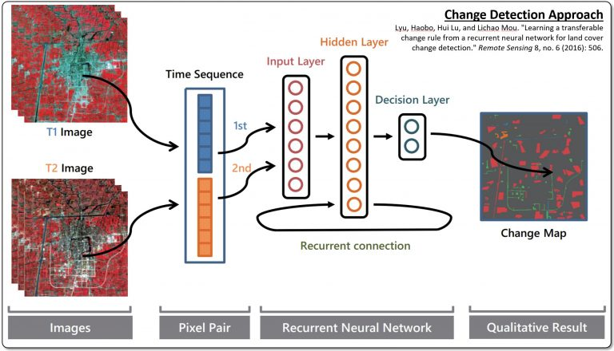
RECURRENT NEURAL NETWORKS (RNNS) FOR CHANGE DETECTION [4]
Utilizes RNN for land cover change detection by analyzing sequential images T1 and T2.
RNN, specialized for sequential data like temporal images, processes the input.
Mentions CRNNs, a variant handling grid-like data, although not explicitly in the diagram.
Extracts features using ConvLSTM, capable of capturing long-term dependencies.
Recurrent connection enables leveraging past information for current image processing.
Employs attention mechanism to emphasize crucial features for change detection.
Decision layer likely generates change map pinpointing areas of divergence between images.
Change Detection using Convolutional Recurrent Neural Networks (CRNNs)
Source

Slide 19
FULLY CONVOLUTIONAL NETWORKS (FCNS) FOR CHANGE DETECTION [4]
End-to-End Pixel-wise Classification
FCNs enable end-to-end pixel-wise classification, allowing for the direct prediction of change labels for each pixel in remote sensing imagery.
By leveraging convolutional layers, FCNs process input images spatially and generate output predictions at the pixel level.
Preservation of Spatial Information
FCNs preserve spatial information throughout the network architecture, maintaining the spatial context of input images.
This preservation of spatial information ensures that local features and spatial relationships are considered during the change detection process.

Slide 20
CONVOLUTIONAL LONG SHORT-TERM MEMORY NETWORKS (CONVLSTMS) FOR CHANGE DETECTION [5]
Modeling Spatial and Temporal Dependencies
ConvLSTMs extend CNNs with Long Short-Term Memory (LSTM) units, enabling them to model both spatial and temporal dependencies simultaneously.
By combining convolutional and recurrent operations, ConvLSTMs can capture complex spatiotemporal patterns in remote sensing imagery.

Slide 21
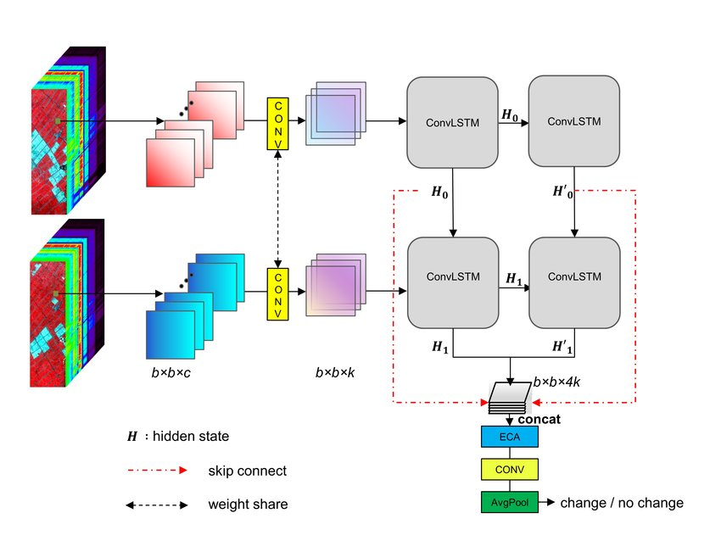
CONVLSTMS FOR CHANGE DETECTION [5]
ConvLSTM layers extract temporal features via two paths, each with three layers.
ECA block focuses on important image features.
Concat layer merges outputs from both paths.
Skip connect layer adds input image to output for long-term learning.
Weight share convolutional layer applies shared filter across all time steps.
Average pooling reduces dimensionality.
Final layer is binary classification for pixel change probability.
Architecture of the proposed multi-path convolutional LSTM for change detection. [5]
Source

Slide 22
CONVOLUTIONAL LONG SHORT-TERM MEMORY NETWORKS (CONVLSTMS) FOR CHANGE DETECTION [5]
Effective for Spatiotemporal Change Detection
ConvLSTMs are particularly effective for spatiotemporal change detection tasks, where changes occur over both space and time.
They can analyze multi-temporal satellite images and detect changes in land cover, urban areas, and environmental features while considering their temporal evolution.

Slide 23
ADVANTAGES OF DEEP LEARNING FOR CD
Automatic Feature Learning:
Deep learning models automatically learn relevant features from raw remote sensing data, eliminating the need for manual feature engineering.
Integration of Multispectral and Hyperspectral Imagery:
Deep learning can effectively integrate information from multiple spectral bands, improving change detection accuracy and robustness.
Transfer Learning:

Slide 24
ADVANTAGES OF DEEP LEARNING FOR CD
Transfer learning techniques allow pretrained deep learning models to be fine-tuned for specific change detection tasks, even with limited labeled data.
Improved Accuracy and Robustness.
Deep learning methods typically achieve higher accuracy and robustness compared to traditional change detection methods, especially in complex and dynamic environments.

Slide 25
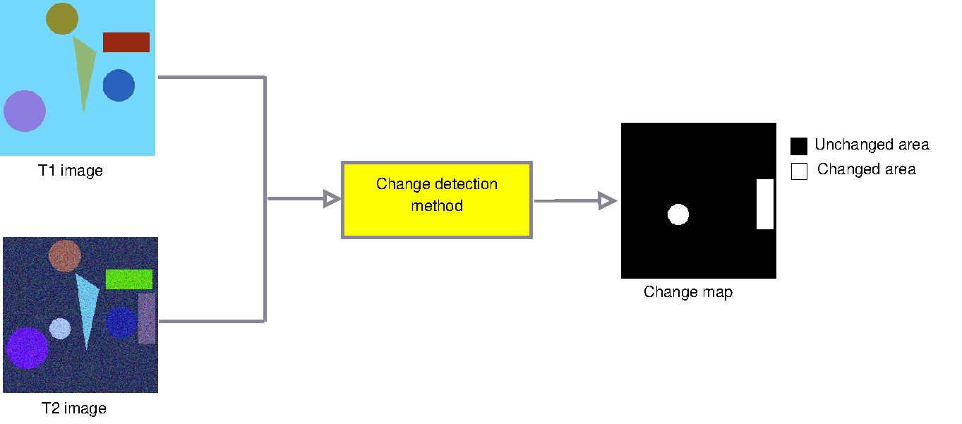
ADVANTAGES OF DEEP LEARNING FOR CD
Deeplearning & Change Detection in Remotesensing
Source

Slide 26
APPLICATIONS OF DEEP LEARNING IN CD
Deep learning techniques, like convolutional neural networks (CNNs), are good at automatically detecting urban expansion from satellite images.
These algorithms compare satellite images taken at different times to identify areas where new buildings, roads, and other infrastructure have been built, indicating urban growth and change.
By analyzing the spatial and temporal patterns in the images, deep learning models can detect these urban changes and transformations.
Using deep learning for urban change detection provides a powerful tool to monitor and manage urban growth. This information can be very useful for urban planning, building new infrastructure, and allocating resources.

Slide 27
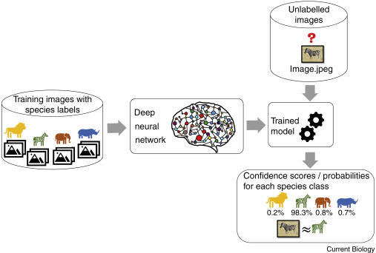
APPLICATIONS OF DEEP LEARNING IN CD
Environmental Monitoring:
Environmental monitoring involves tracking changes in natural ecosystems, land cover, and habitat conditions. Deep learning techniques offer powerful tools for automatically detecting and analyzing environmental changes from satellite imagery:
Deforestation Monitoring: Deep learning algorithms can analyze satellite images to detect areas of deforestation, forest degradation, and forest fragmentation. By monitoring changes in forest cover and structure, these algorithms support conservation efforts and sustainable forest management practices.
Source

Slide 28
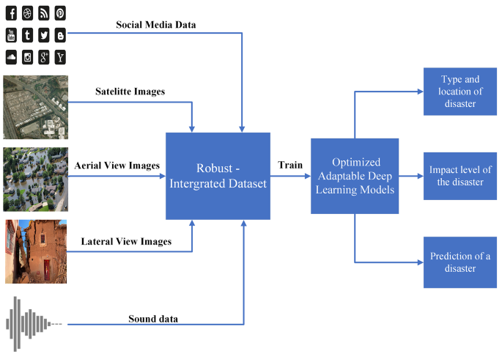
APPLICATIONS OF DEEP LEARNING IN CD
Disaster Response:
During natural disasters such as floods, earthquakes, and wildfires, rapid and accurate mapping of the affected areas is crucial for effective disaster response and recovery efforts. Deep learning models offer advanced capabilities for analyzing satellite imagery and mapping the extent of disaster-affected areas:
Flood Mapping: Deep learning algorithms can analyze satellite images to detect flooded areas, assess the extent of flooding, and identify vulnerable populations and infrastructure. By providing real-time information on flood extents, these algorithms support emergency response efforts, evacuation planning, and flood risk management.
Source

Slide 29
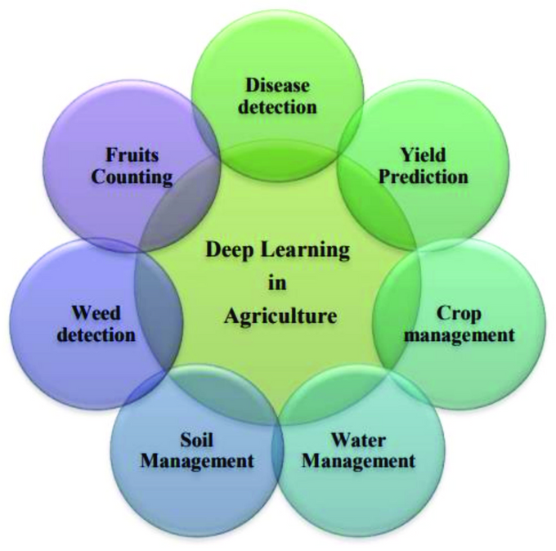
APPLICATIONS OF DEEP LEARNING IN CD
Agricultural Monitoring:
Agricultural monitoring involves tracking crop health, land use patterns, and agricultural productivity to support sustainable food production and resource management practices. Deep learning techniques offer advanced capabilities for analyzing satellite imagery and monitoring agricultural systems:
SOURCE

Slide 30
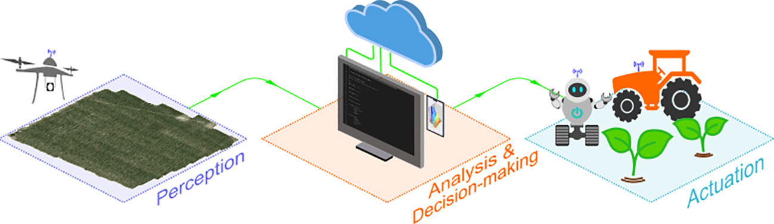
APPLICATIONS OF DEEP LEARNING IN CD
Agricultural Monitoring:
Crop Health Monitoring: Deep learning algorithms can analyze satellite images to assess crop health, detect diseases and pests, and monitor crop growth and development. By providing early warning signs of potential crop stressors, these algorithms support precision agriculture practices and decision-making by farmers.
SOURCE

Slide 31
PROPOSED METHOD: COUPLED DICTIONARY AND DEEP LEARNING
Coupled Dictionary and Deep Learning integrates a module for spatial-temporal relationship capture in multi-temporal images.
It employs a Differential Feature Discriminant Network and a new loss function for optimizing change detection accuracy.
These advanced techniques enhance both accuracy and generalization in change detection tasks.

Slide 32
COUPLED DICTIONARY LEARNING MODULE
Objective: The primary goal of this module is to capture the intricate spatial-temporal relationships existing between corresponding pixels across multi-temporal images.
Method: It accomplishes this by employing a coupled dictionary learning approach, where a dictionary is learned jointly from pairs of multi-temporal images. This dictionary representation effectively encodes both spatial and temporal information in a unified manner.

Slide 33
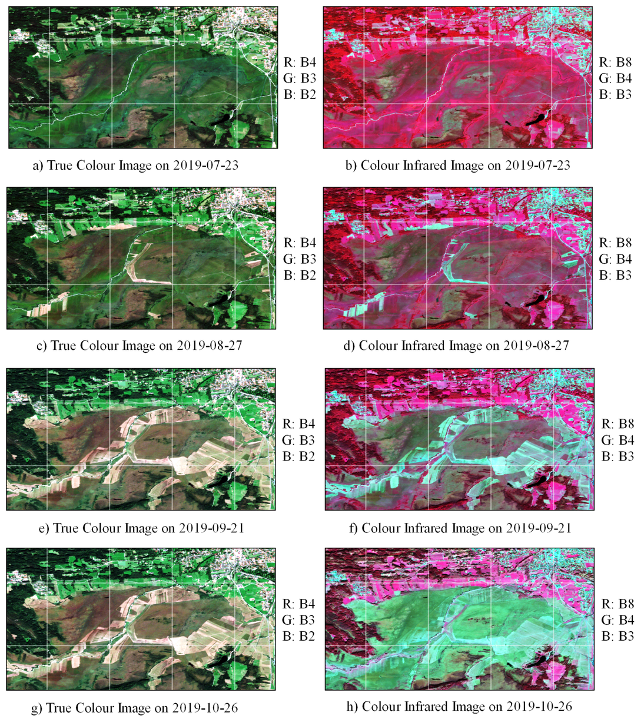
DIFFERENTIAL FEATURE DISCRIMINANT NETWORK
Objective: The main objective of this network is to utilize the learned coupled dictionary to extract differential features that emphasize changes between multi-temporal images.
Method: The network architecture is specifically designed to leverage the information encoded in the coupled dictionary. By processing the input images through convolutional layers and utilizing the dictionary as a set of filters, the network can extract features that highlight the differences between corresponding pixels.
SOURCE

Slide 34
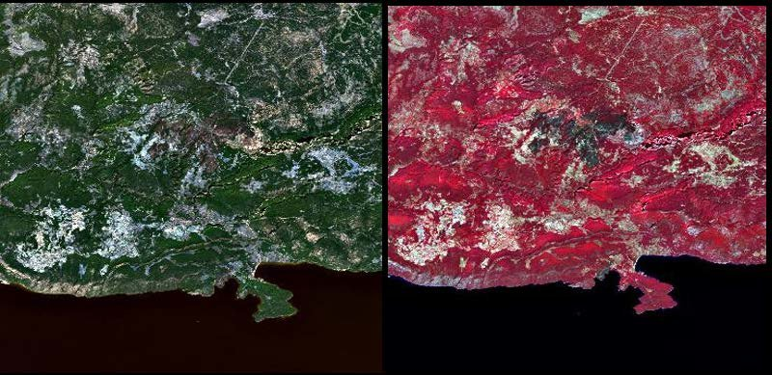
NEW LOSS FUNCTION - TRUE/FALSE DISCRIMINATION LOSS
Objective: This component aims to ensure that the network effectively distinguishes between true changes and false positives during the training process.
Method: A specific loss term, known as the True/False Discrimination Loss, is introduced into the training objective. This loss penalizes the network for incorrectly labeling unchanged regions as changed (false positives) or vice versa, encouraging the model to make more accurate distinctions between different types of changes.
Source

Slide 35
NEW LOSS FUNCTION - CLASSIFICATION LOSS
Objective: This component focuses on guiding the network towards correctly classifying changed pixels within the input images.
Method: A classification loss term is incorporated into the training objective, which penalizes misclassifications of changed pixels. This loss encourages the network to assign the correct label (changed or unchanged) to each pixel, leading to more accurate change detection results.

Slide 36
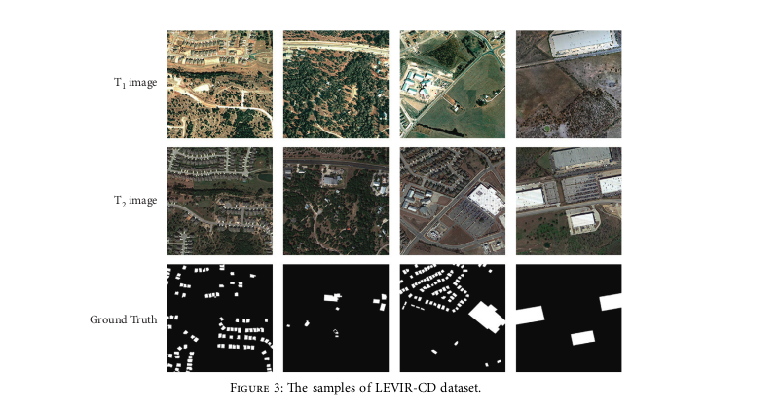
DATASET
Dataset:
The second dataset is the LEVIR-CD dataset. The dataset contains 637 pairs of CD 1024 ×1024 images with a spatial resolution of 0.5 m. The images were collected from 20 diﬀerent locations in Texas between 2002 and 2018. This dataset helps train more eﬃcient CD models while focusing on interesting changes and reducing the impact of other irrelevant changes on the model.

Slide 37
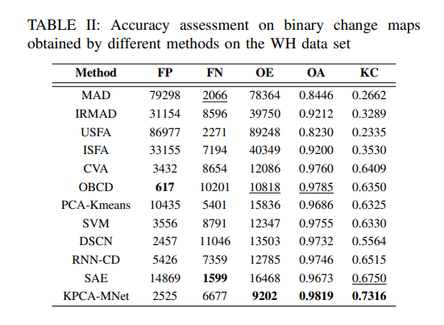
RESULTS
Comparison Table

Slide 38
BENEFITS OF THE PROPOSED METHOD
The coupled dictionary and deep learning approach offer several advantages:
Good accuracy in change detection, especially for edge pixels and small objects.
Increased robustness to variations in image data, including noise, illumination changes, and seasonal variations.
These benefits enhance the effectiveness of change detection in remote sensing applications, leading to more reliable results and better decision-making.

Slide 39
LITERATURE REVIEW-1
A Change Detection Method for Remote Sensing Images Based on Coupled Dictionary and Deep Learning
Authors-Weiwei Yang , Haifeng Song , Lei Du , Songsong Dai , and Yingying Xu
Publishing Year- 2022
(1) In this paper, a change detection framework based on coupled dictionary learning is proposed to map
multisource and multitemporal data from low-dimensional space to high-dimensional space and then
estimate its change.
(2) A diﬀerential feature extraction network is proposed to construct a new reconstruction loss by integrating
true-false discrimination loss, classiﬁcation loss, and cross-entropy loss, which is conducive to training the coupled dictionary with stronger representation ability.
(3) The multisource remote sensing image change detection is realized by combining the advantages of
model driven method (coupled dictionary learning) and data driven method (diﬀerential feature extraction network), and data from diﬀerent observation spaces can be modeled uniformly.

Slide 40
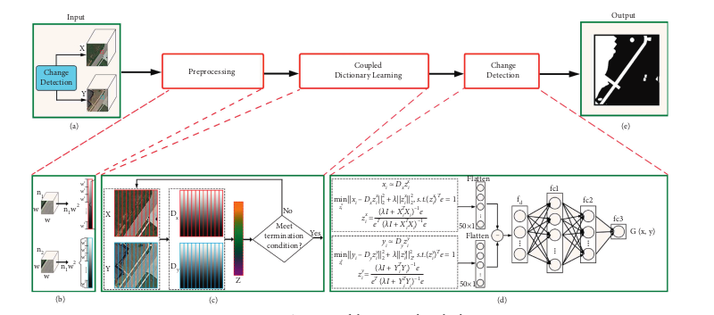
LITERATURE REVIEW-1

Slide 41
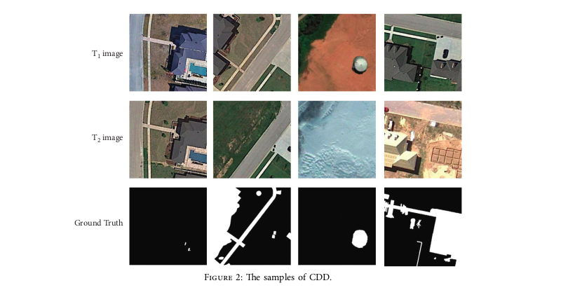
LITERATURE REVIEW-1
Dataset:
The ﬁrst dataset is the CDD. It consists of seven pairs of images with 4725 ×2700 resolution obtained from Google Earth. A total of 16,000 image pairs (10,000 in the training set, 3,000 in the test set, and 3,000 in the validation set) with a spatial resolution of 3 − 100 cm were collected from the seven pairs of images.
The second dataset is the LEVIR-CD dataset. The dataset contains 637 pairs of CD 1024 ×1024 images with a spatial resolution of 0.5 m. The images were collected from 20 diﬀerent locations in Texas between 2002 and 2018. This dataset helps train more eﬃcient CD models while focusing on interesting changes and reducing the impact of other irrelevant changes on the model.

Slide 42
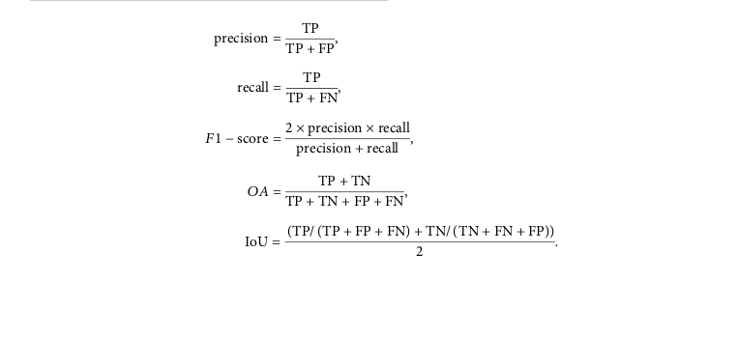
LITERATURE REVIEW-1
Used Metrics-

Slide 43
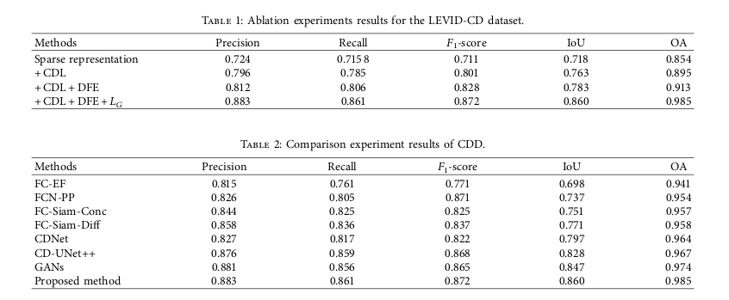
LITERATURE REVIEW-1
Results-

Slide 44
LITERATURE REVIEW-2
A Change Detection Method for Remote Sensing Images Based on Coupled Dictionary and
Deep Learning
Authors: Liu et al.
Publishing year: 2020
Focus:
Provides a comprehensive review of deep learning-based change detection methods for remote sensing images
Key Aspects:
Categorizes deep learning techniques for change detection into supervised, unsupervised, and hybrid approaches
Discusses the advantages and limitations of different deep learning architectures, such as CNNs, RNNs, and GANs
Examines the impact of data preprocessing, network design, and training strategies on change detection performance
Highlights emerging trends and future research directions in this field

Slide 45
LITERATURE REVIEW-3
Change Detection Methods for Remote Sensing in the Last Decade
Authors:
JCheng, Guangliang
Huang, Yunmeng
Li, Xiangtai
Lyu, Shuchang
Xu, Zhaoyang
Zhao, Qi
Xiang, Shiming
Year of Publication: 2023
Focus:
Provides a comprehensive review of change detection methods for remote sensing in the last decade
Key Aspects:
Categorizes change detection methods into traditional, object-based, and deep learning-based approaches
Discusses the principles, characteristics, and performances of different methods
Examines the impact of data preprocessing, change indicators, and evaluation metrics on change detection
Highlights the emerging trends, challenges, and future research directions in this field

Slide 46
LITERATURE REVIEW-4
Change Detection Methods for Remote Sensing in the Last Decade
Authors:
JCheng, Guangliang
Huang, Yunmeng
Li, Xiangtai
Lyu, Shuchang
Xu, Zhaoyang
Zhao, Qi
Xiang, Shiming
Year of Publication: 2023
Focus:
Provides a comprehensive review of change detection methods for remote sensing in the last decade
Key Aspects:
Categorizes change detection methods into traditional, object-based, and deep learning-based approaches
Discusses the principles, characteristics, and performances of different methods
Examines the impact of data preprocessing, change indicators, and evaluation metrics on change detection
Highlights the emerging trends, challenges, and future research directions in this field

Slide 47
LITERATURE REVIEW-4
Learning Multiscale Temporal–Spatial–Spectral Features via a Multipath Convolutional LSTM Neural Network for Change Detection With Hyperspectral Images
Authors:
Shi, Changjiang and Zhang, Zhijie and Zhang, Wanchang and Zhang, Chuanrong and Xu, Qiang
Year of Publication: 2022
Focus:
Utilizing a Multipath Convolutional Long Short-Term Memory Neural Network (MP-ConvLSTM) for change detection with hyperspectral images (HSIs), integrating temporal, spatial, and spectral features to enhance accuracy and robustness.
Key Aspects:
Effective utilization of DLNs with HSIs for change detection, leveraging their rich spectral and spatial information.
Modeling multiscale temporal dependencies to extract discriminative information for land use and cover changes.
Addressing challenges in preserving time-dependent features with the proposed MP-ConvLSTM architecture.
Integration of LSTM and CNN in a parallel architecture to learn multilevel temporal dependencies from bitemporal HSIs.
Utilization of feature refinement techniques like the Efficient Channel Attention (ECA) module and Siamese CNN for enhanced representation and dimensionality reduction.

Slide 48





REFERRENCES
Yang, W., Song, H., Du, L., Dai, S., & Xu, Y. (2022, January 17). A Change Detection Method for Remote Sensing Images Based on Coupled Dictionary and Deep Learning. Computational Intelligence and Neuroscience, 2022, 1–14. https://doi.org/10.1155/2022/3404858
Shafique, A., Cao, G., Khan, Z., Asad, M., & Aslam, M. (2022, February 11). Deep Learning-Based Change Detection in Remote Sensing Images: A Review. Remote Sensing, 14(4), 871. https://doi.org/10.3390/rs14040871
JCheng, Guangliang & Huang, Yunmeng & Li, Xiangtai & Lyu, Shuchang & Xu, Zhaoyang & Zhao, Qi & Xiang, Shiming. (2023). Change Detection Methods for Remote Sensing in the Last Decade: A Comprehensive Review.
J. G. Vinholi, B. G. Palm, D. Silva, R. Machado and M. I. Pettersson, "Change Detection Based on Convolutional Neural Networks Using Stacks of Wavelength-Resolution Synthetic Aperture Radar Images," in IEEE Transactions on Geoscience and Remote Sensing, vol. 60, pp. 1-14, 2022, Art no. 5236414, doi: 10.1109/TGRS.2022.3211010.
Shi, C., Zhang, Z., Zhang, W., Zhang, C., & Xu, Q. (2022). Learning Multiscale Temporal–Spatial–Spectral Features via a Multipath Convolutional LSTM Neural Network for Change Detection With Hyperspectral Images. IEEE Transactions on Geoscience and Remote Sensing, 60, 1–16. https://doi.org/10.1109/tgrs.2022.3176642

Slide 49
CONCLUSION
The coupled dictionary and deep learning approach offers a promising advancement in change detection for remote sensing images.
It effectively captures spatial-temporal relationships and utilizes deep learning techniques.
This method achieves superior accuracy, especially in scenarios involving edge pixels and small objects.

Slide 50
THANK YOU

